Slide 1
GROSS ANATOMY OF THE DUODENUM
BY
DR OJEWALE A.O

Slide 2
Outline
Intro’
Functions
Shape & location
Parts & relations
Suspensory muscle of duodenum
Duodenal recesses (fossae)
Arterial supply
Venous drainage
Nerve supply
Lymphatic drainage
Applied Anatomy

Slide 3
Intro
The duodenum is the first, shortest, widest, and the most fixed part of the small intestine.
It extends from the pylorus to the duodenojejunal flexure. It is 10 inches (25 cm) long.
It begins at the pylorus which lies on the transpyloric plane about 2.5 cm to the right of the median plane and ends at the duodenojejunal junction which lies about 2.5 cm to the left of the median plane and little below the transpyloric plane.

Slide 4
It is retroperitoneal except the proximal 2.5 cm, which is suspended above by the lesser omentum and below by the greater omentum.
The main function of the duodenum is digestion. It receives chyme from the stomach which is mixed with bile and pancreatic enzymes.

Slide 5
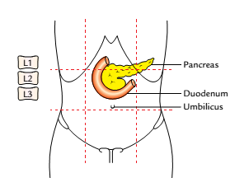
SHAPE AND LOCATION
It is a “C”-shaped loop of the small intestine. The concavity of the duodenal loop encloses the head of pancreas.
It is located in the abdominal cavity above the level of the umbilicus opposite to the L1, L2, L3 vertebrae.
Location of the duodenum

Slide 6
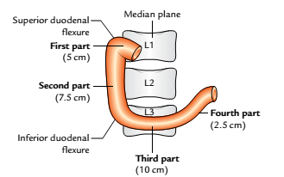
PARTS AND RELATIONS
It is measured 25 cm long, it is also divided into four parts namely:
Superior (first) part, 5 cm (2 inches) long.
Descending (second) part, 7.5 cm (3 inches) long.
Horizontal (third) part, 10 cm (4 inches) long.
Ascending (fourth) part, 2.5 cm (1 inch) long.
Parts of the duodenum

Slide 7
FIRST PART OF THE DUODENUM
Course
It begins at the pylorus, passes upward, backward, and laterally to the right side of the vertebral column to reach the neck of the gallbladder, where it curves downward (superior duodenal flexure) to become continuous with the second part of the duodenum.

Slide 8
Features
It develops from the foregut.
It is only partly retroperitoneal.
It is freely mobile and distensible.
It has no circular folds in the mucous membrane of its initial 2.5 cm.
It is the site for duodenal ulcer.
It is supplied by the branches of coeliac trunk/artery.

Slide 9
RELATIONS
Anteriorly: Quadrate lobe of the liver and gallbladder.
Posteriorly: Portal vein, gastroduodenal artery, and common bile duct (CBD).
Superiorly: Epiploic foramen being separated from it by the portal vein and bile duct.
Inferiorly: Head and neck of the pancreas.

Slide 10
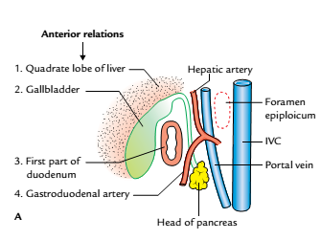
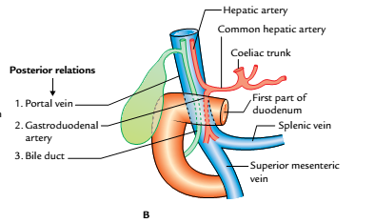
Relations of the first part of the duodenum: A, anterior relations as seen in sectional view; B, posterior relations as seen from anterior aspect (IVC = inferior vena cava)

Slide 11
SECOND PART OF THE DUODENUM
Course
It begins at the superior duodenal flexure, passes downward, in front of the medial part of the right kidney, till the lower border of the L3 vertebra where it curves toward the left (inferior duodenal flexure) to become continuous with the third part.

Slide 12
Features
Its upper half develops from the foregut and lower half from the midgut.
It lies behind the transverse mesocolon.
It receives the bile duct, the chief (main) and accessory pancreatic ducts.
It is the only part of the intestine supplied by double rows of vasa recta, arising from anterior and posterior pancreaticoduodenal arterial arcades.

Slide 13
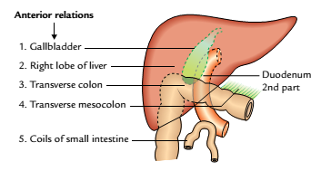
RELATIONS
Anteriorly: Gallbladder and right lobe of the liver, transverse colon, transverse mesocolon (commencement), and coils of the small intestine.
Anterior relations of the second part of the duodenum

Slide 14
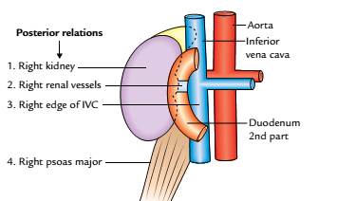
Posteriorly: Right kidney and right renal vessels, right edge of the inferior vena cava (IVC), and right psoas major muscle.
Medially: Head of the pancreas.
Laterally: From below upward, ascending colon, right colic flexure, and right lobe of the liver.
Posterior relations of the second part of the duodenum

Slide 15
THIRD PART OF THE DUODENUM
Course
It runs horizontally to the left, across the lower part of the body of L3 vertebra, crosses in front of IVC, and then takes a smooth curve upward to become continuous with the ascending part of the duodenum.

Slide 16
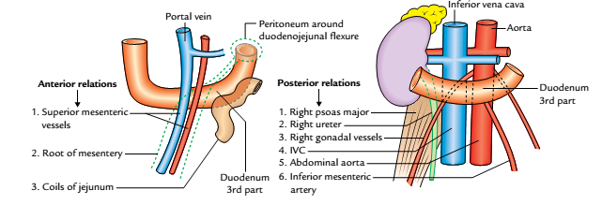
RELATIONS
Anteriorly: Root of the mesentery, superior mesenteric vessels, and coils of the jejunum.
Posteriorly: Right psoas major, right ureter, IVC, abdominal aorta, and right gonadal vessels.
Anterior and posterior relations of the third part of the duodenum.

Slide 17
Cont’d
Superiorly: Head of the pancreas with its uncinate process.
Inferiorly: Coils of the jejunum.

Slide 18
FOURTH PART
Course
It runs upward on, or immediately to the left of the abdominal aorta, from the end of the third part to the upper border of the L2 vertebra where it turns forward (ventrally) to become continuous with the jejunum (duodenojejunal flexure).

Slide 19
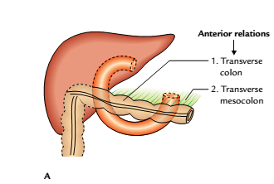
RELATIONS
Anteriorly: Transverse colon and transverse mesocolon.
Posteriorly: Left psoas major muscle, left sympathetic chain, left gonadal vessels, and inferior mesenteric vein.
Anterior relations of the fourth part of the duodenum

Slide 20
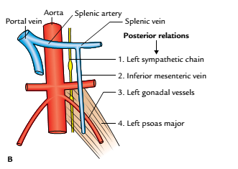
Superiorly: Body of the pancreas.
On to the left: Left kidney and left ureter.
On to the right: Upper part of the root of mesentery.
Posterior relations of the fourth part
of the duodenum

Slide 21
SUSPENSORY MUSCLE OF DUODENUM
It is a fibromuscular band, which suspends the duodenojejunal flexure from the right crus of the diaphragm. Its upper end is attached on to the right crus of the diaphragm and the lower end attached on to the. posterior surface of the duodenojejunal flexure. This band contains:(a) Striated muscle fibres in the upper part, (b) Elastic fibres in the middle part. (c) Non-striated muscle fibres in the lower part.

Slide 22
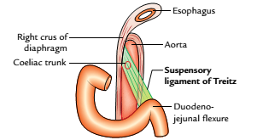
The ligament of Treitz fixes the duodenojejunal flexure and prevents it from being dragged down by the weight of loops of the small intestine. It also serves as an important landmark in the radiological diagnosis of incomplete rotation of the small intestine.
Suspensory ligament of Treitz

Slide 23
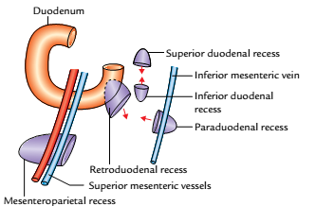
DUODENAL RECESSES (FOSSAE)
In the region of duodenojejunal junction, small pocket like pouches of peritoneum called duodenal recesses do occur.
Duodenal recesses

Slide 24
Cont’d
These are sometimes responsible for strangulated retroperitoneal hernia. The important peritoneal recesses around the duodenojejunal flexure are as follows:
Superior duodenal recess: It lies to the left upper end of the fourth part of the duodenum, behind the superior duodenojejunal peritoneal fold with its orifice looking downward.

Slide 25
Inferior duodenal recess: It lies a little below the superior recess behind the inferior duodenojejunal peritoneal fold with its orifice looking upward.
Paraduodenal recess: It is the lowest when present. It lies to the left of the fourth part of the duodenum behind the paraduodenal fold of the peritoneum with its orifice facing medially. The paraduodenal fold contains inferior mesenteric vein in its free border edge.

Slide 26
Retroduodenal recess: It is the largest of duodenal recesses, but is rarely present. If present, it lies behind the third and fourth parts of the duodenum. Its orifice looks downward and to the left.

Slide 27
ARTERIAL SUPPLY
The upper half of the duodenum develops from the foregut and the lower half from the midgut. Therefore, the arterial supply of the upper half is derived from the coeliac trunk (artery of the foregut) and that of the lower half from the superior mesenteric artery (artery of the midgut). The different arteries of the duodenum derived directly or indirectly from the above two arteries are

Slide 28
Superior pancreaticoduodenal artery, a branch of gastroduodenal artery (a branch of hepatic artery from the coeliac trunk).
Inferior pancreaticoduodenal artery, a branch of the superior mesenteric artery.
Each of the Superior and Inferior pancreaticoduodenal arteries divide into anterior and posterior branches then anastomose to form anterior and posterior pancreaticoduodenal arterial arcades.
Each anastomotic arterial arcade gives off a row of vasa recta.

Slide 29
The vasa recta of the anterior arcade supply the anterior surface and those of the posterior arcade supply the posterior surface of the duodenum.
Between the two rows of vasa recta lies the head of the pancreas.

Slide 30
Supraduodenal artery, a branch of the gastroduodenal artery from the coeliac trunk and supplies the anterosuperior and posterosuperior surfaces of the first part of duodenum.
Artery from the first jejunal branch of the superior mesenteric artery: It supplies branches to the fourth part of the duodenum.
Retroduodenal branches of the gastroduodenal artery.
Branches from the right gastroepiploic artery.

Slide 31
VENOUS DRAINAGE
The veins correspond to the arteries but are superficial to them. They drain into the splenic, superior mesenteric, and portal veins.

Slide 32
NERVE SUPPLY
The sympathetic nerves to the duodenum are derived from T6-T9 segments of the spinal cord and parasympathetic nerves from both the vagi through coeliac and superior mesenteric plexuses. From these plexuses, fibres run along the arteries of the duodenum to supply it.

Slide 33
LYMPHATIC DRAINAGE
The lymph vessels follow the arteries and most of them drain into pancreaticoduodenal nodes lying along the inner curve of the duodenum (junction of the pancreas and duodenum). The efferents drain into coeliac and superior mesenteric lymph nodes and ultimately via intestinal lymph trunk into the cisterna chyli.

Slide 34
APPLIED ANATOMY
Duodenal ulcer: The duodenal ulcers commonly occur in the first part of the duodenum because it is supplied by a series of end arteries and receives the acidic chyme from the stomach.
Duodenal injuries: The second part of the duodenum is most protected from external injury because it lies in the paravertebral gutter-a deeper plane than the forward curvature of the vertebral column.

Slide 35
Cont’d
The third part of the duodenum is most vulnerable to external injury because it gets crushed between the vertebral column and the anterior abdominal wall following violence.
Duodenal diverticula: They are congenital and almost always occur in the medial wall of the second part of the duodenum. They are thought to be caused by herniation of the duodenal lining through the gaps in the muscle coat where arteries and ducts pierce the wall.

Slide 36
Referred pain: The pain arising from duodenum is poorly localized and referred to the central epigastrium.

Slide 37


